Slide 1
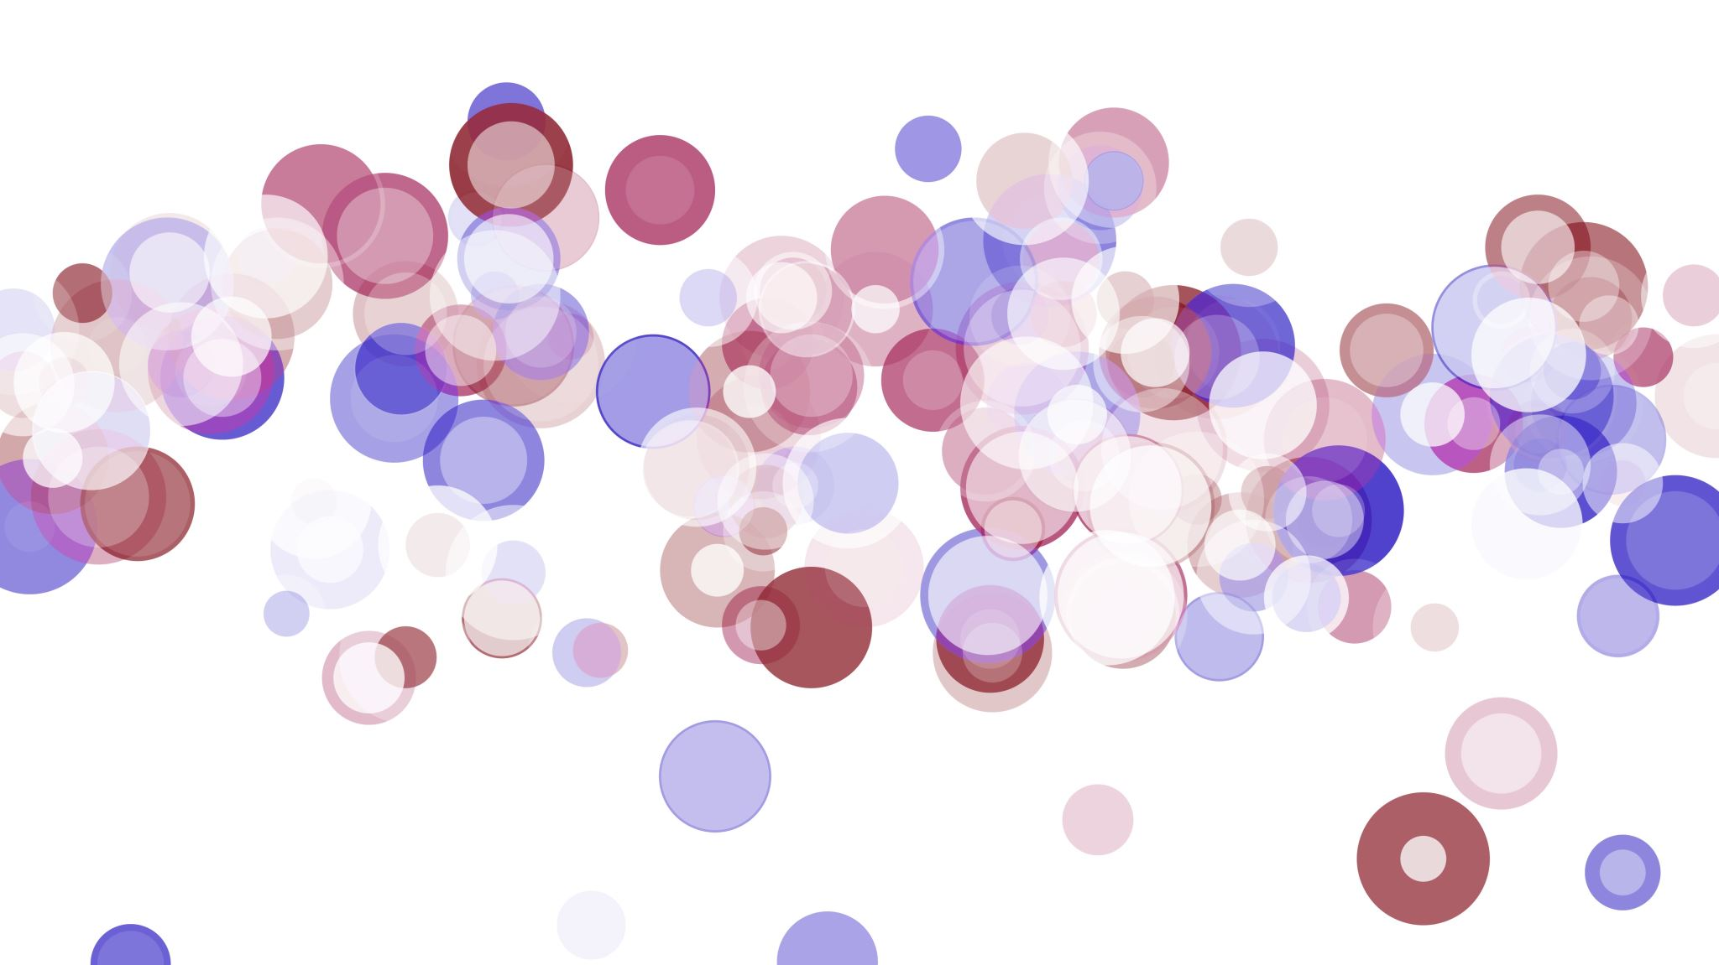
Detecting and Blurring Framed Objects on Walls Using YOLOv8 and Streamlit
An AI-Powered Solution for Privacy Protection

Slide 2
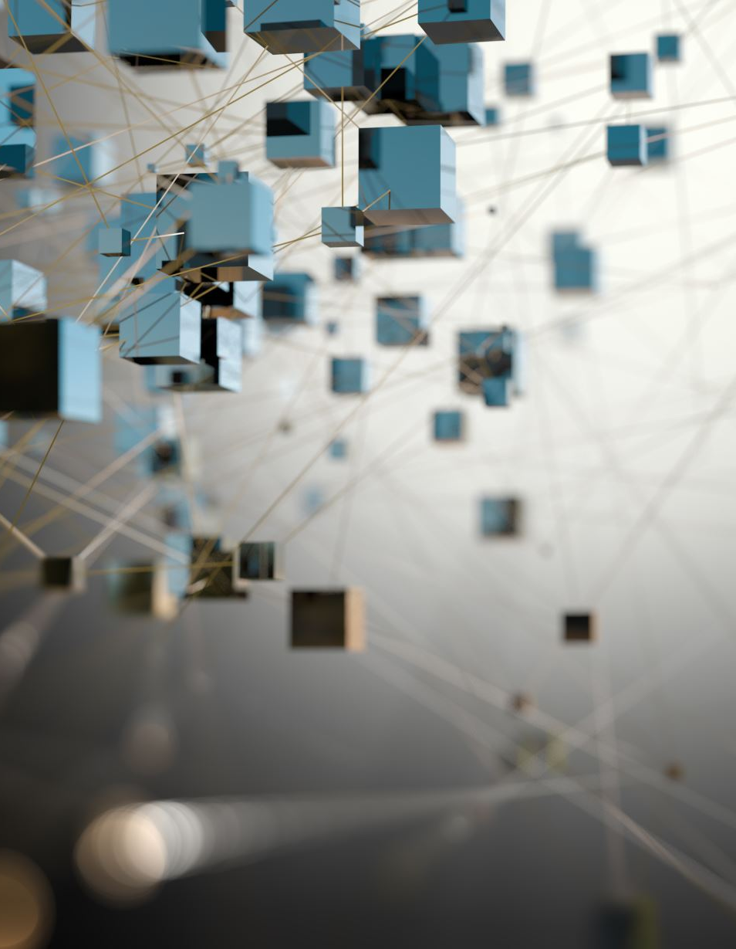
Introduction to the Project
Problem Statement: Personal photos, art, and other framed objects in shared spaces can lead to privacy concerns.
Solution Overview: Using AI to automatically detect and blur these objects in images and videos.
Technology Stack: Roboflow, YOLOv8, Streamlit, Python.

Slide 3

Project Goals
Primary Goal: Develop a model to detect and blur framed objects on walls.
Sub-goals:
High accuracy in detection.
Efficient blurring technique that maintains overall image quality.
User-friendly interface for uploading and processing images/videos.

Slide 4
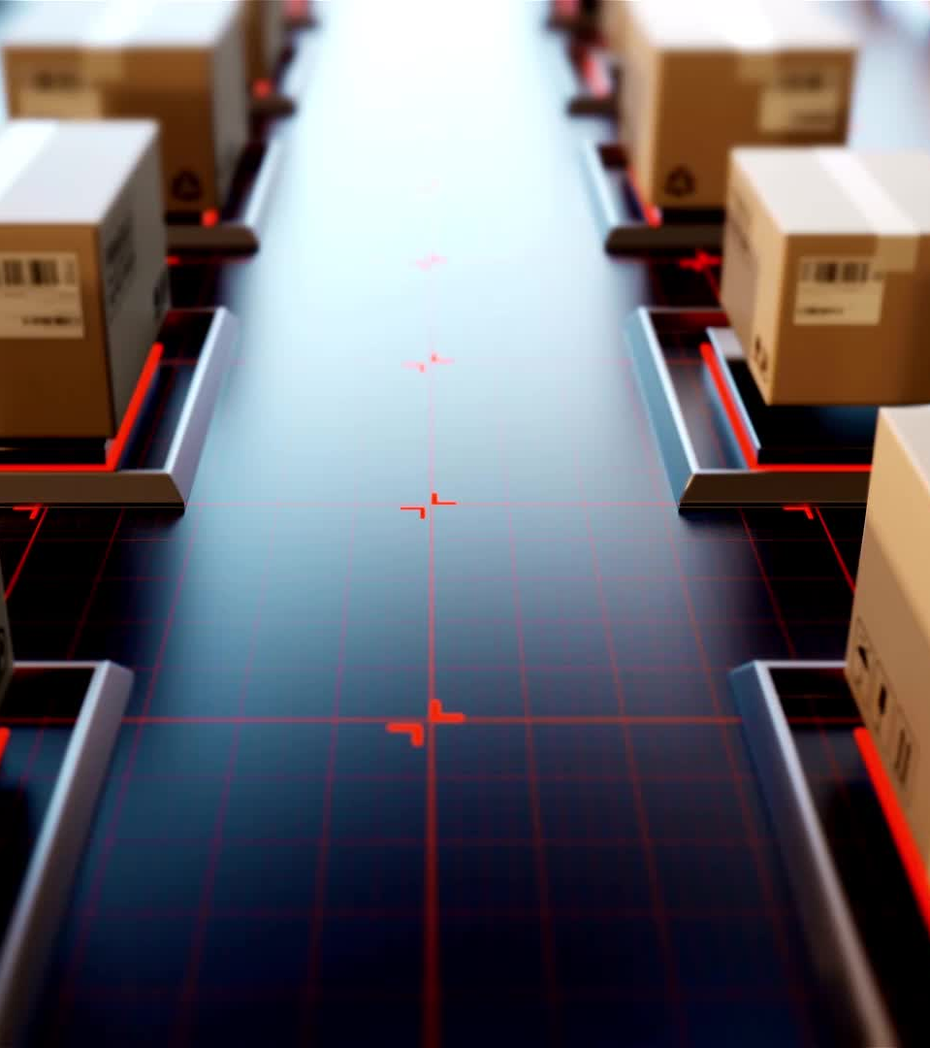
Data Collection and Preparation
Data Sources: Images and videos of various indoor environments.
Annotation Tool: Roboflow for annotating images with bounding boxes around framed objects.
Dataset Size: Collecting and annotating at least 1000 images.
Data Augmentation: Techniques such as rotation, scaling, and flipping to enhance dataset diversity.

Slide 5
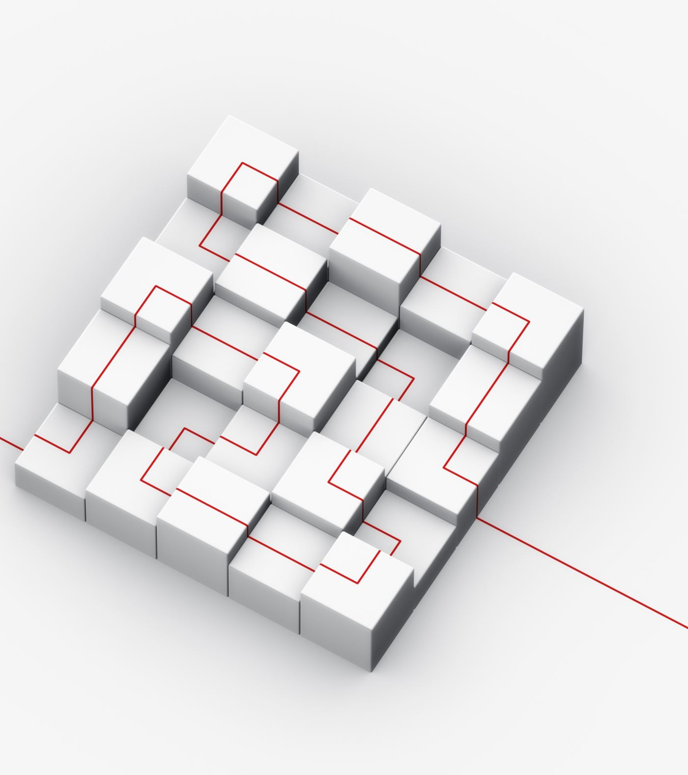
Model Selection - YOLOv8
Why YOLOv8?
State-of-the-art object detection model.
High accuracy and real-time performance.
Pre-trained models available for quick deployment.
Model Architecture:
Overview of YOLOv8 architecture.
Customization for detecting framed objects.

Slide 6

Training the Model
Content:
Training Setup:
Using Google Colab for training.
Hyperparameters: epochs, batch size, learning rate.
Training Process:
Loading the annotated dataset.
Fine-tuning the pre-trained YOLOv8 model.
Monitoring training metrics such as loss and accuracy.
Validation:
Splitting data into training and validation sets.
Evaluating model performance using mAP50-95.

Slide 7
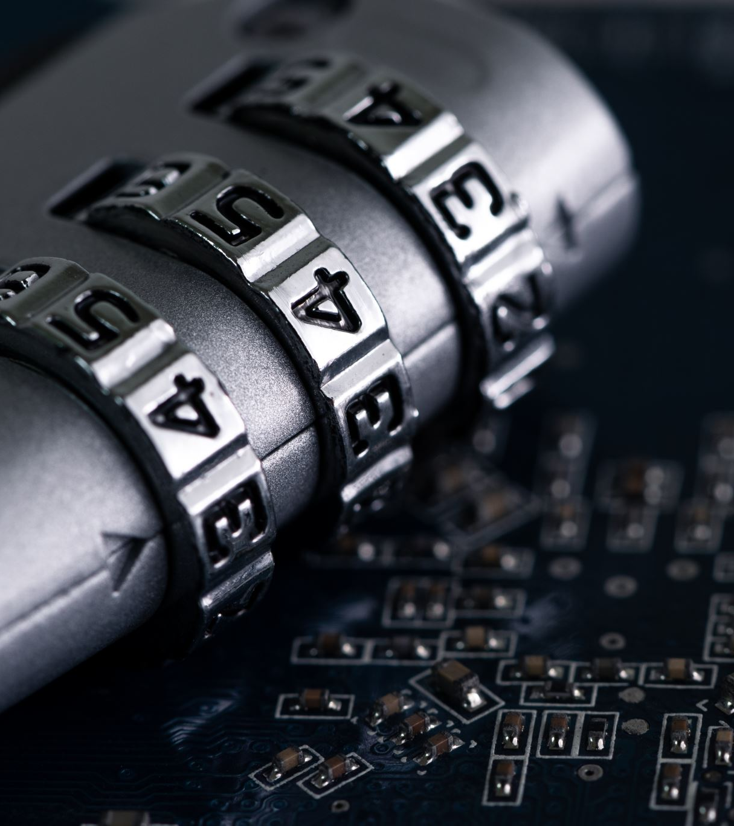
Implementing the Blurring Technique
Content:
Blurring Algorithm:
Gaussian blur applied to detected regions.
Ensuring blurring preserves the aesthetics of the image.
Integration with YOLOv8:
Post-processing step after detection.
Efficient and seamless application of the blur filter.

Slide 8

Building the User Interface with Streamlit
Why Streamlit?
Rapid development of interactive web applications.
Easy integration with Python.
Features:
Upload images and videos.
Display original and processed images/videos.
Option to download processed files.
UI Design:
Simple and intuitive layout for user interaction.
Real-time feedback on processing status.

Slide 9
Deployment and Scalability
Deployment Options:
Hosting on cloud platforms (e.g., AWS, GCP).
Containerization using Docker for consistent deployment.
Scalability Considerations:
Handling large volumes of images and videos.
Ensuring real-time processing capabilities.
Future Enhancements:
Extending detection to other privacy-sensitive objects.
Continuous model improvement with more data.

Slide 10
Business Impact and Conclusion
Privacy Protection:
Enhancing privacy in shared and public spaces.
Application in sectors like real estate, interior design, and social media.
Market Potential:
Growing demand for privacy-preserving technologies.
Competitive advantage with state-of-the-art AI solutions.
Conclusion:
Summary of the project benefits.
Call to action for stakeholders to support and invest in the project.

